Slide 1
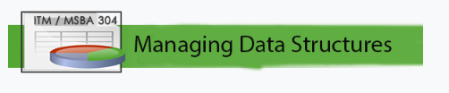
Final Project Team Project
QSN Retail (E-commerce)
Professor Helen Yelluas
Project Team: Quinton Lopez
Sung Keum
Nikita Sarda
David Smarsh
Notes:
Golden Gate University
www.ggu.edu

Slide 2
Agenda
QSNRetail Description
Entity Relationship Diagram (ERD)
18 Analytical Questions
Each Analytical Question Details
  Table Data
  SQL Query
  Graph

Slide 3
QSNRetail Description
QSN Retail Inc., is an e-commerce company that sells variety of products to everyday shoppers. Think of Amazon.com but we do it better and faster. Our goal is to provide an exceptional service and high-quality products to our customers to meet their everyday needs and wants. We encourage customers to return to us for their future purchases through our generous reward system. Our products are supplied by the finest vendors from all over world, whom we handpicked through rigorous process, and routinely undergo quality assurance testing. Our company offers many different payment options for our customers and utilizes third-party logistics companies to facilitate transactions. We are QSNRetail!

Slide 4
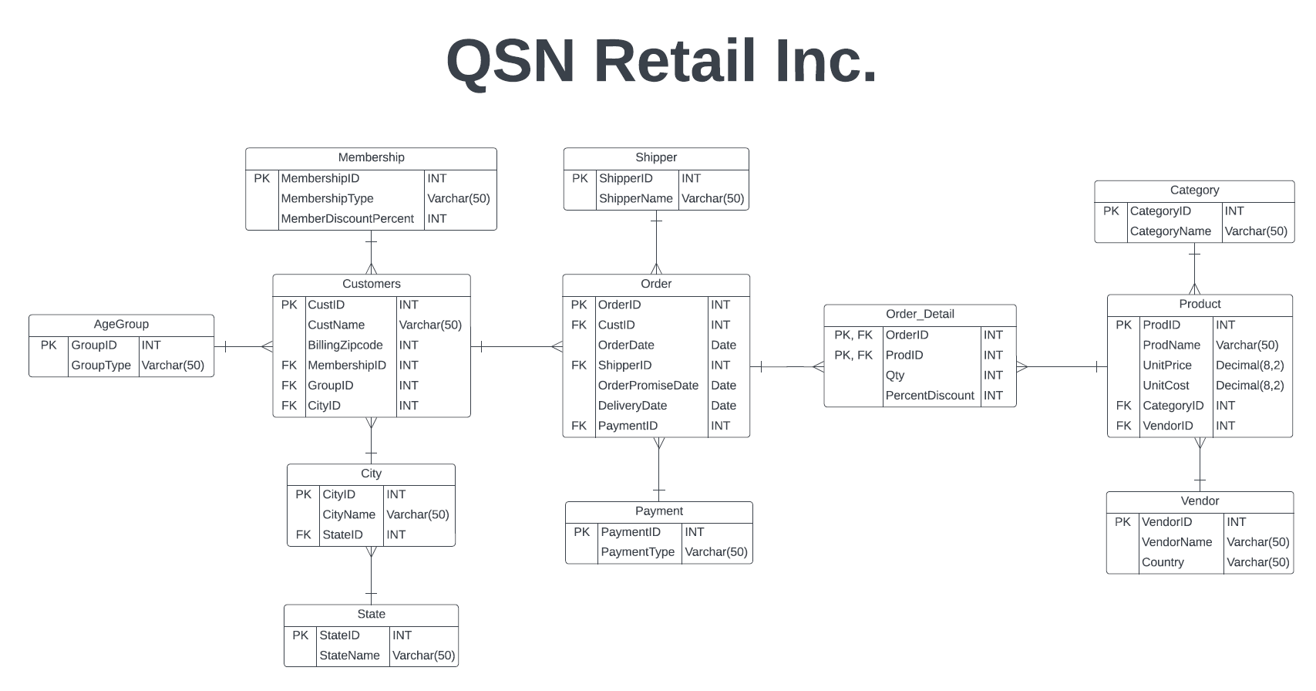
QSN Retail
Entity Relationship Diagram (ERD)

Slide 5
Analytical Questions
QSN Retail
(1 of 2)
18 Analytical Questions (1 – 9)
1. Total sales by year by age group
2. Total sales by month and year
3. Total sales by year by membership type
4. Number of late deliveries for each shipper by year
5. Total sales by year by different payment type
6. Number of deliveries by each shipper by year
7. Total profit by month and year
8. Total sales by category by year
9. Total profit by category by year

Slide 6
Analytical Questions
QSN Retail
(2 of 2)
Analytical Questions (10 – 18)
10. Average number of products per basket by month and year
11. Average ticket per basket by month and year
12. Total discounts received by our customers by month and year
13. Number of products sold by year
14. Number of products sold by category by year
15. Payment to each supplier by year
16. Total number of products provided by each supplier by year
17. Total payment to suppliers by country by year
18. Total discounts received by membership type by year

Slide 7
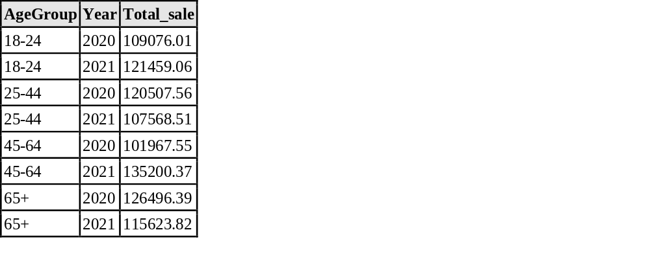
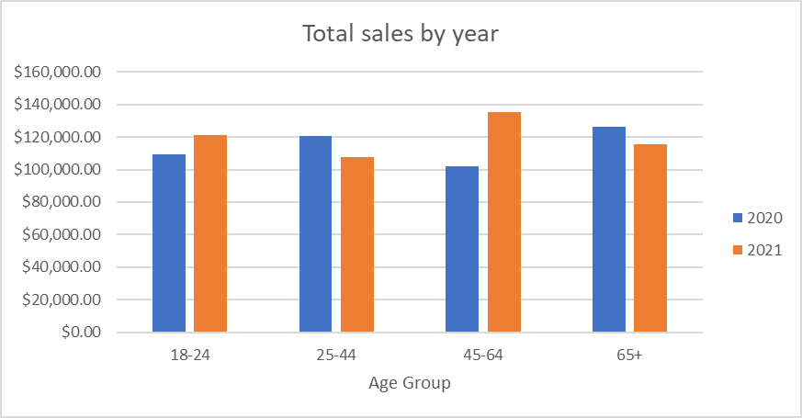
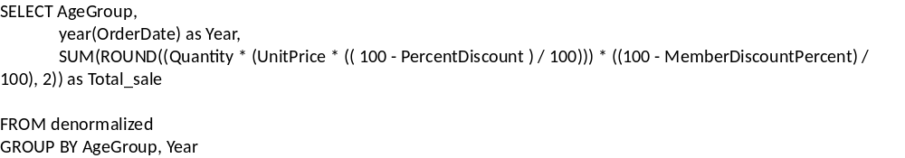
Analytical Question 1
Total sales by year by age group
Data Graph and SQL Query
Sample Data
SQL
Graph

Slide 8
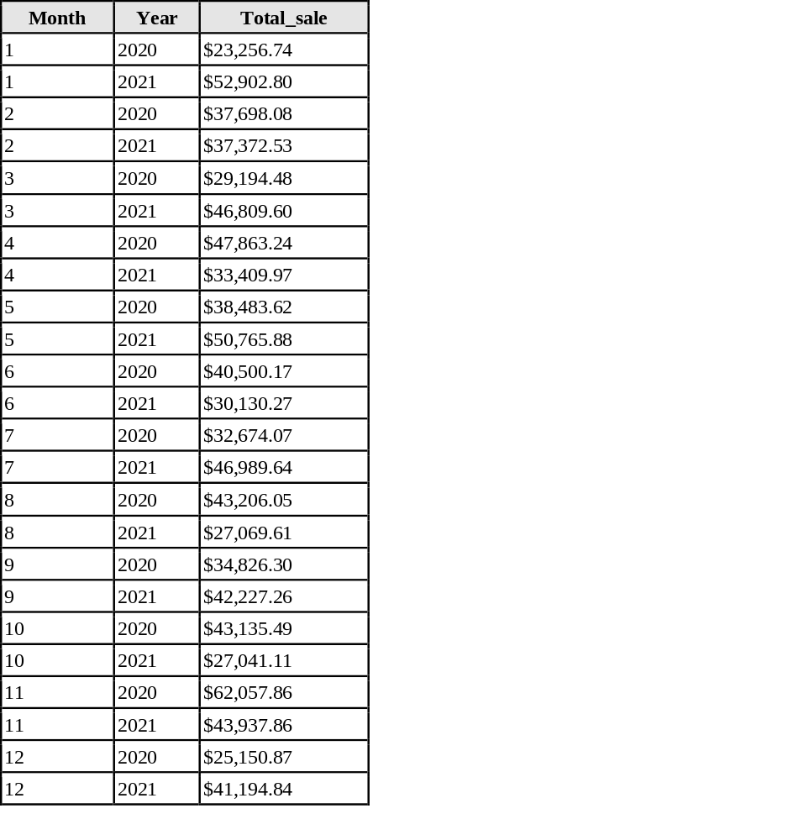
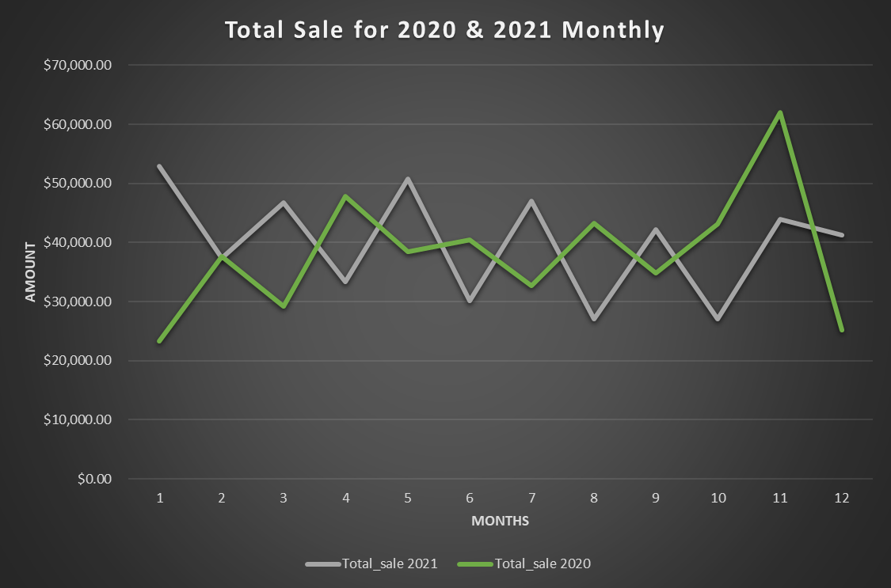
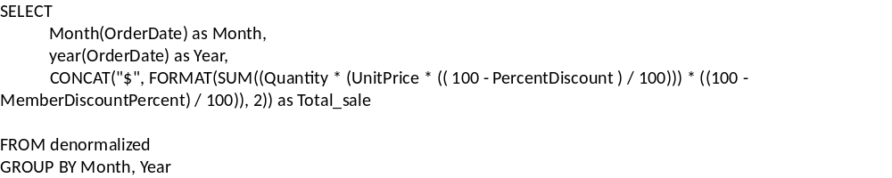
Analytical Question 2
Total sales by month and year
Data Graph and SQL Query
Sample Data
SQL
Graph

Slide 9
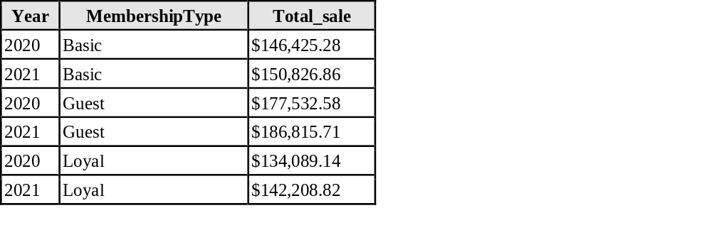
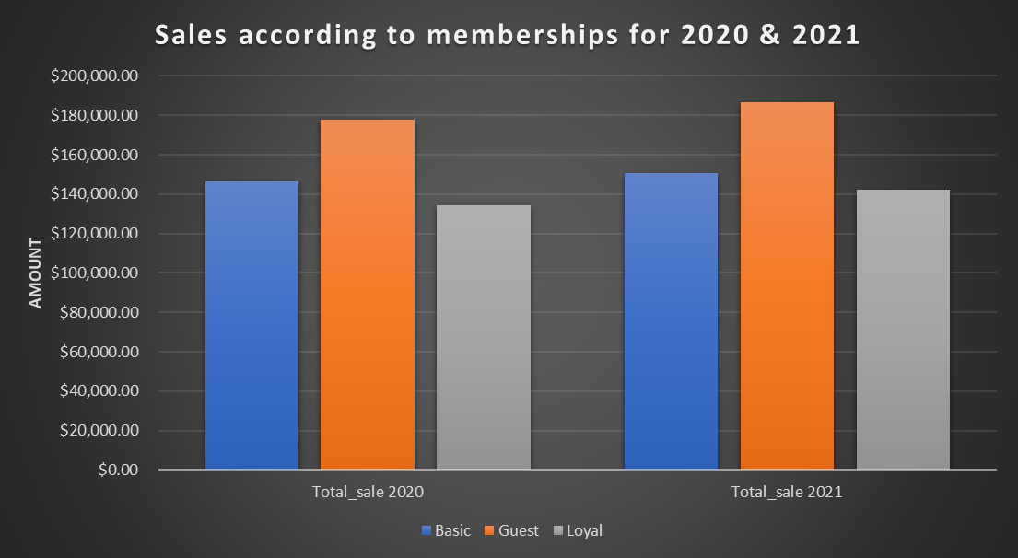
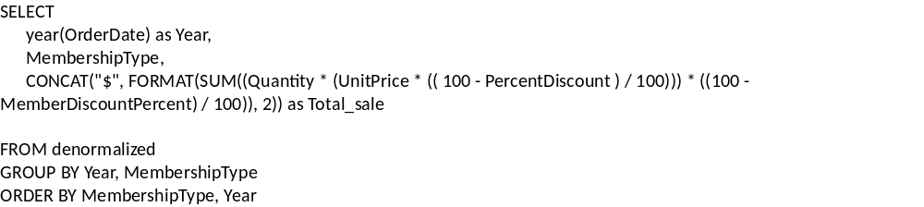
Analytical Question 3
Total sales by year by membership type
Data Graph and SQL Query
Sample Data
SQL
Graph

Slide 10
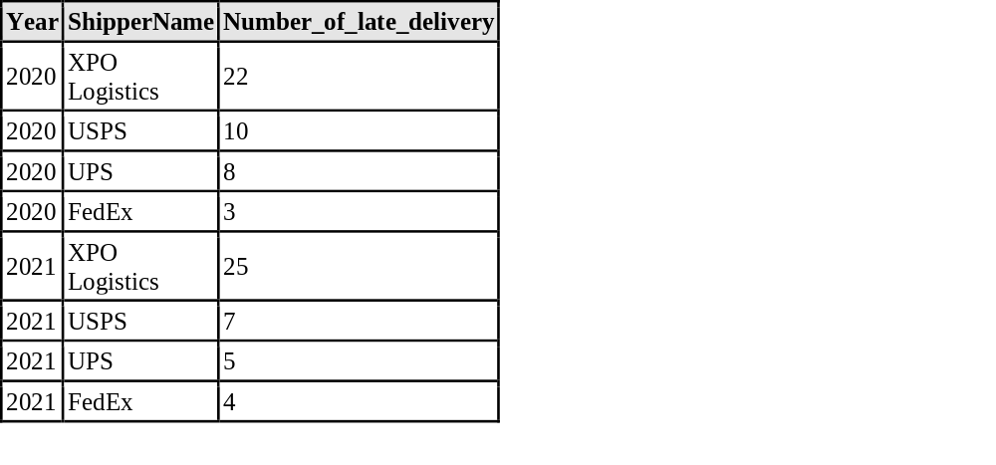
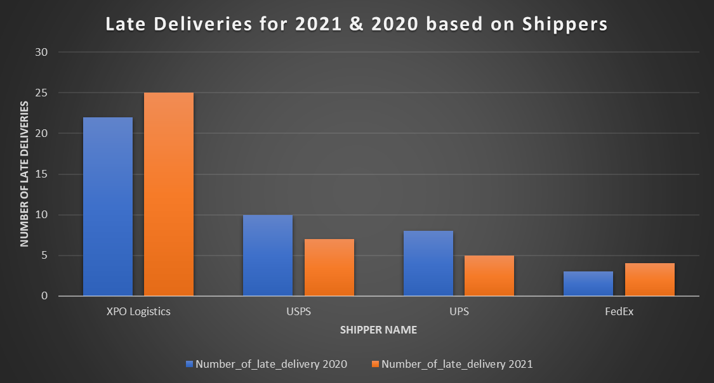
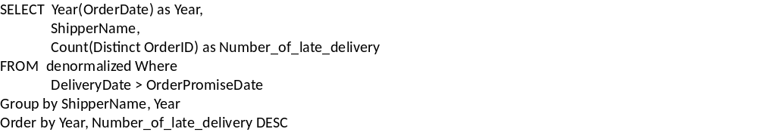
Analytical Question 4
Number of late deliveries for each shipper by year
Data Graph and SQL Query
Sample Data
SQL
Graph

Slide 11
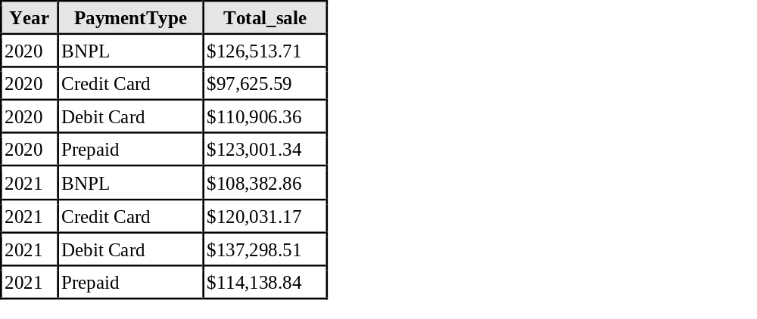
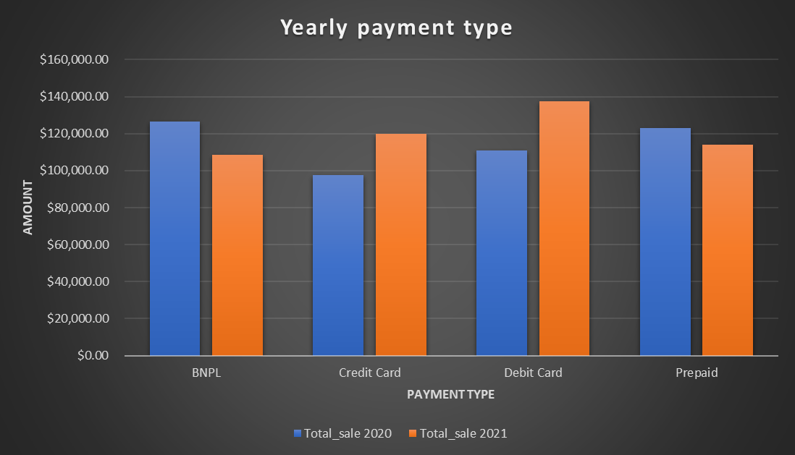
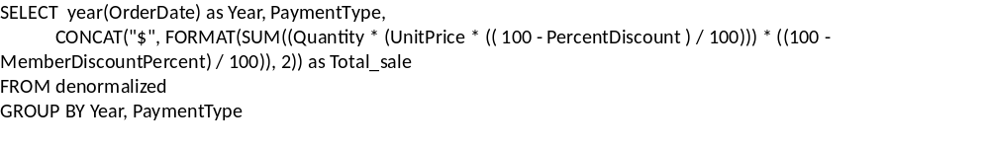
Analytical Question 5
Total sales by year by different payment type
Data Graph and SQL Query
Sample Data
SQL
Graph

Slide 12
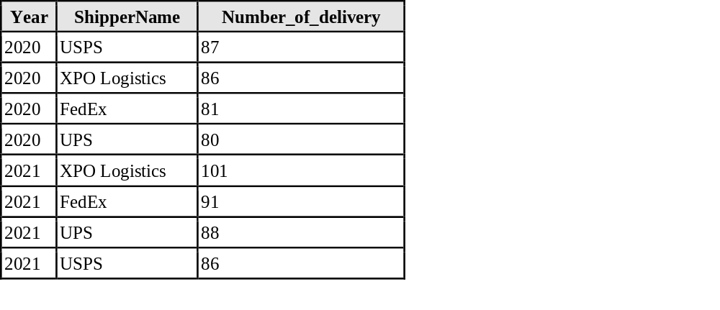
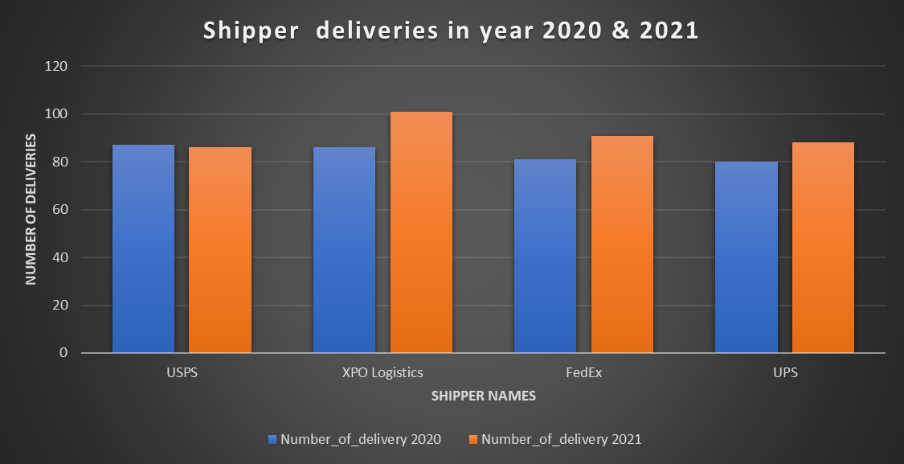
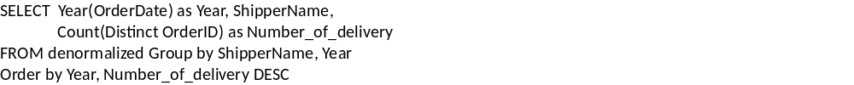
Analytical Question 6
Number of deliveries by each shipper by year
Data Graph and SQL Query
Sample Data
SQL
Graph

Slide 13
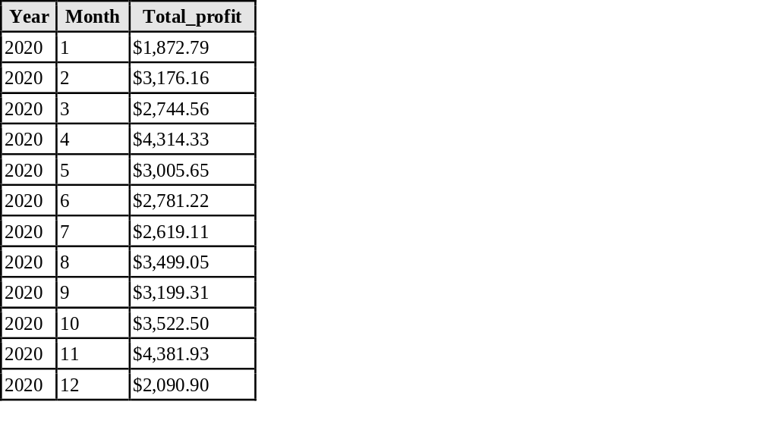
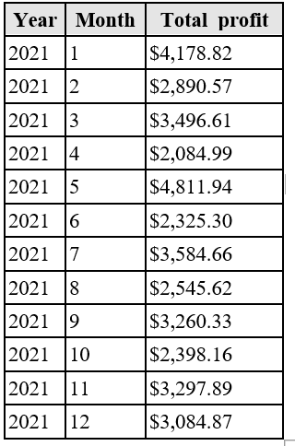
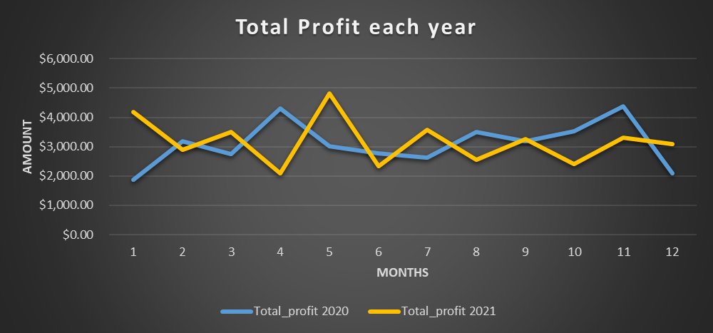
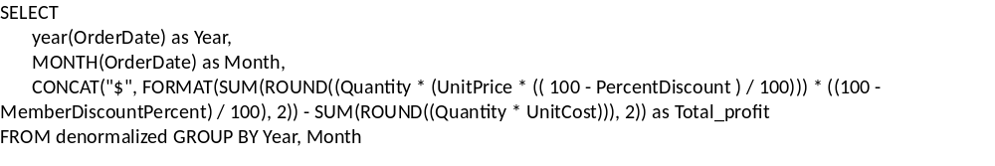
Analytical Question 7
Total profit by month and year
Data Graph and SQL Query
Sample Data
SQL
Graph

Slide 14
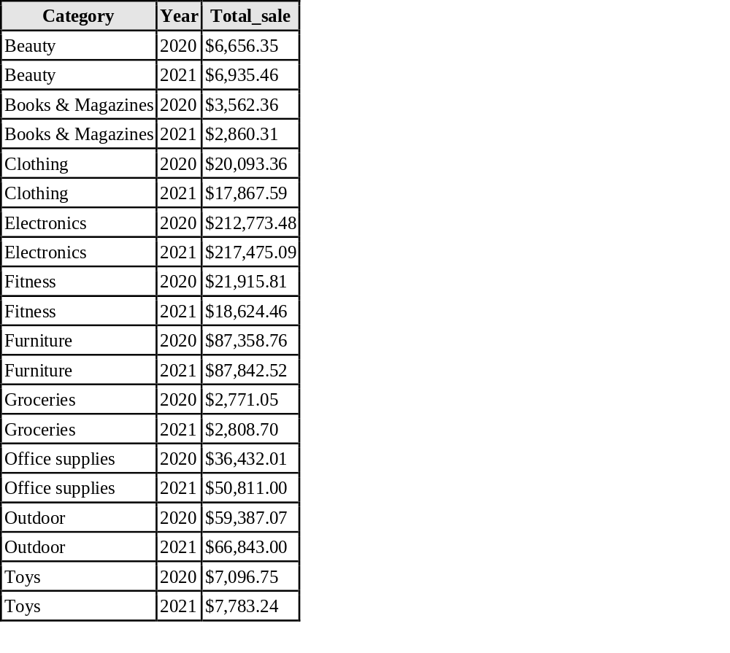
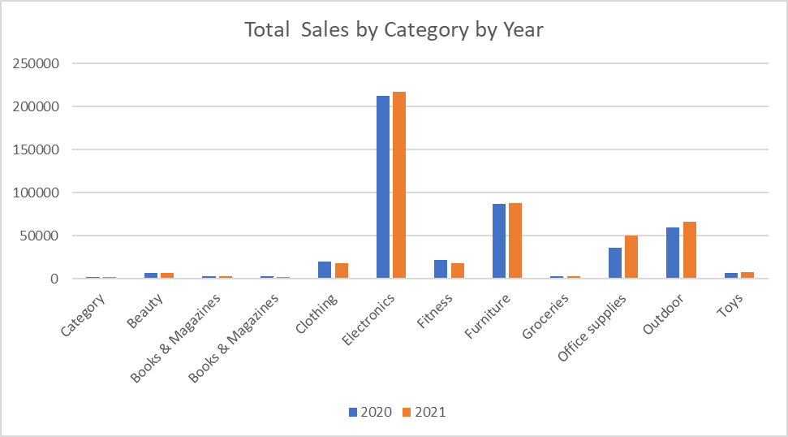
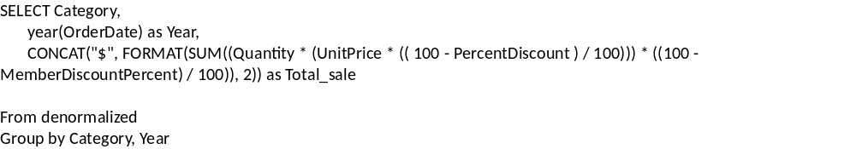
Analytical Question 8
Total sales by category by year
Data Graph and SQL Query
Sample Data
SQL
Graph

Slide 15
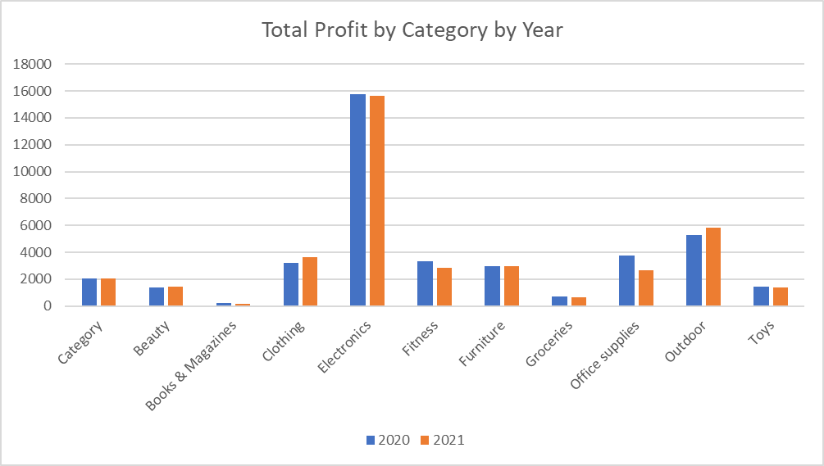
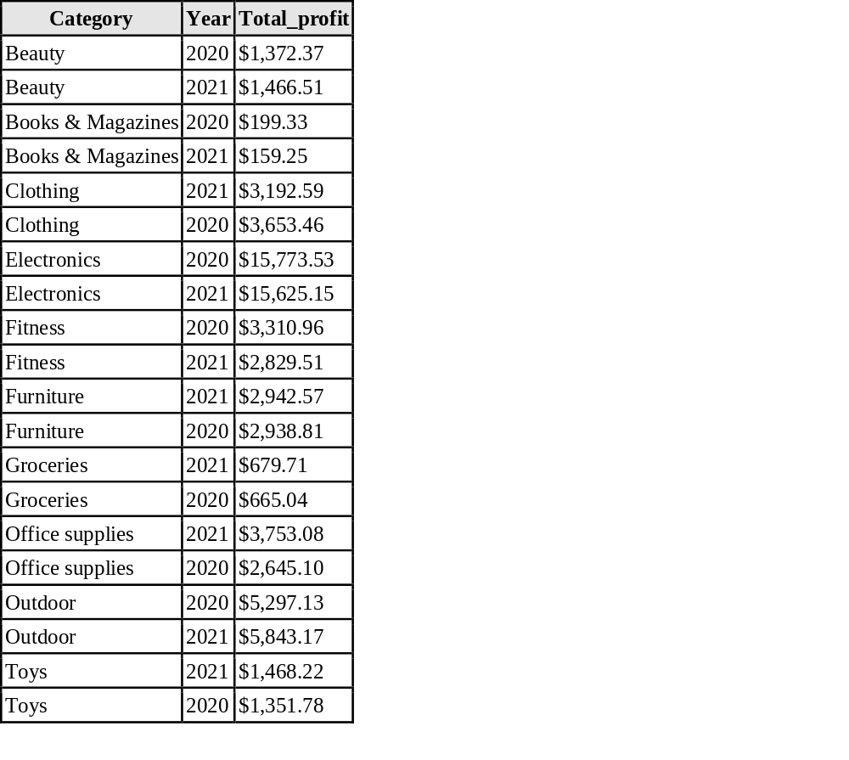
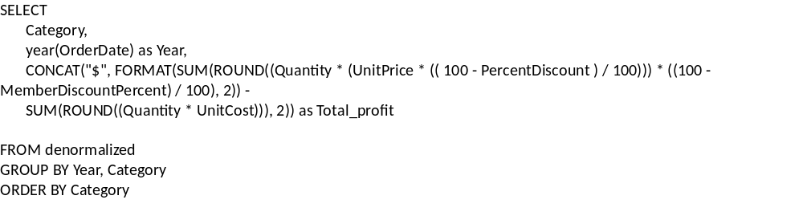
Analytical Question 9
Total profit by category by year
Data Graph and SQL Query
Sample Data
SQL
Graph

Slide 16
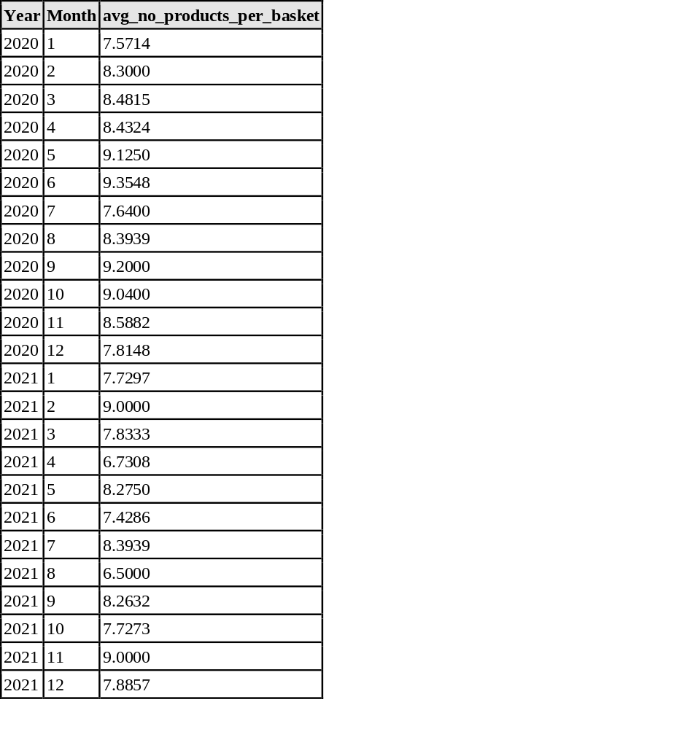
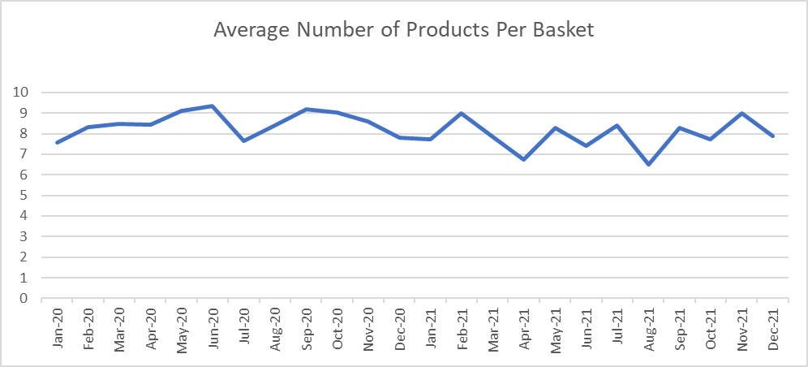
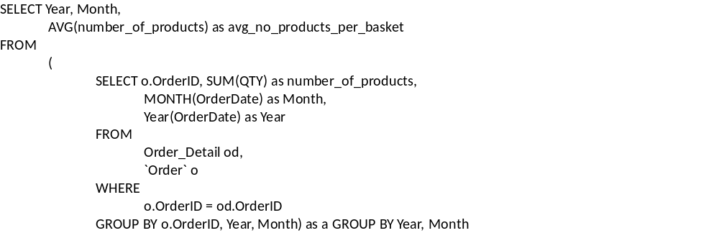
Analytical Question 10
Average number of products per basket by month and year - Data Graph and SQL Query
Sample Data
SQL
Graph

Slide 17
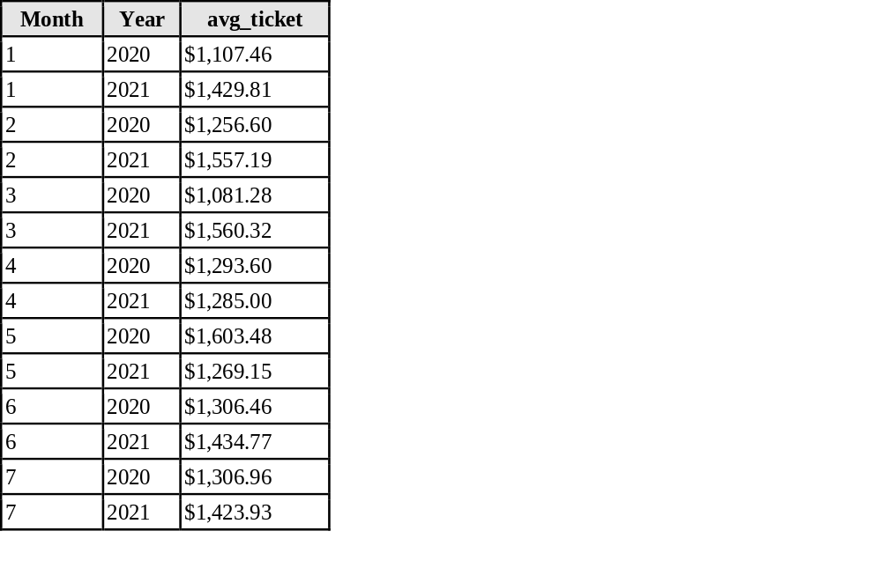
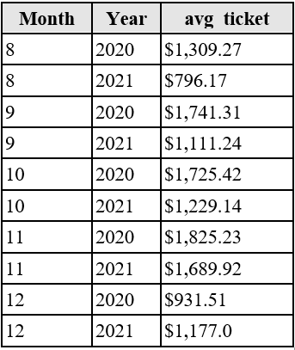
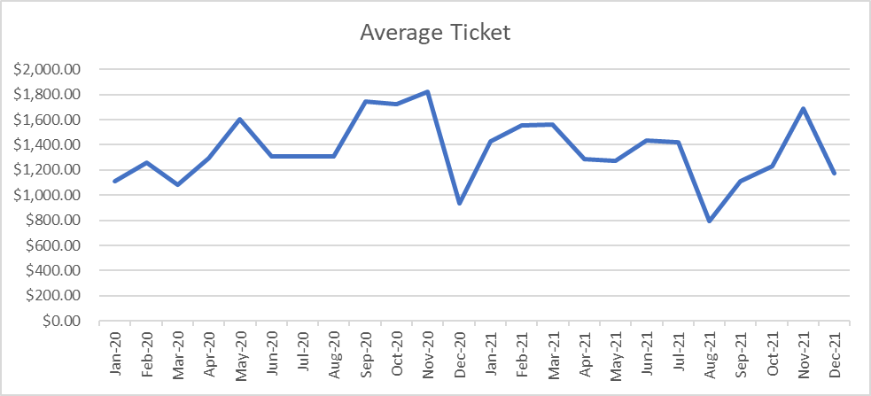
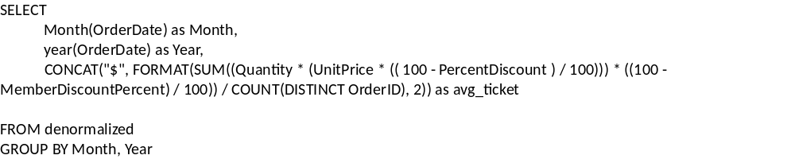
Analytical Question 11
Average ticket per basket by month and year
Data Graph and SQL Query
Sample Data
SQL
Graph

Slide 18
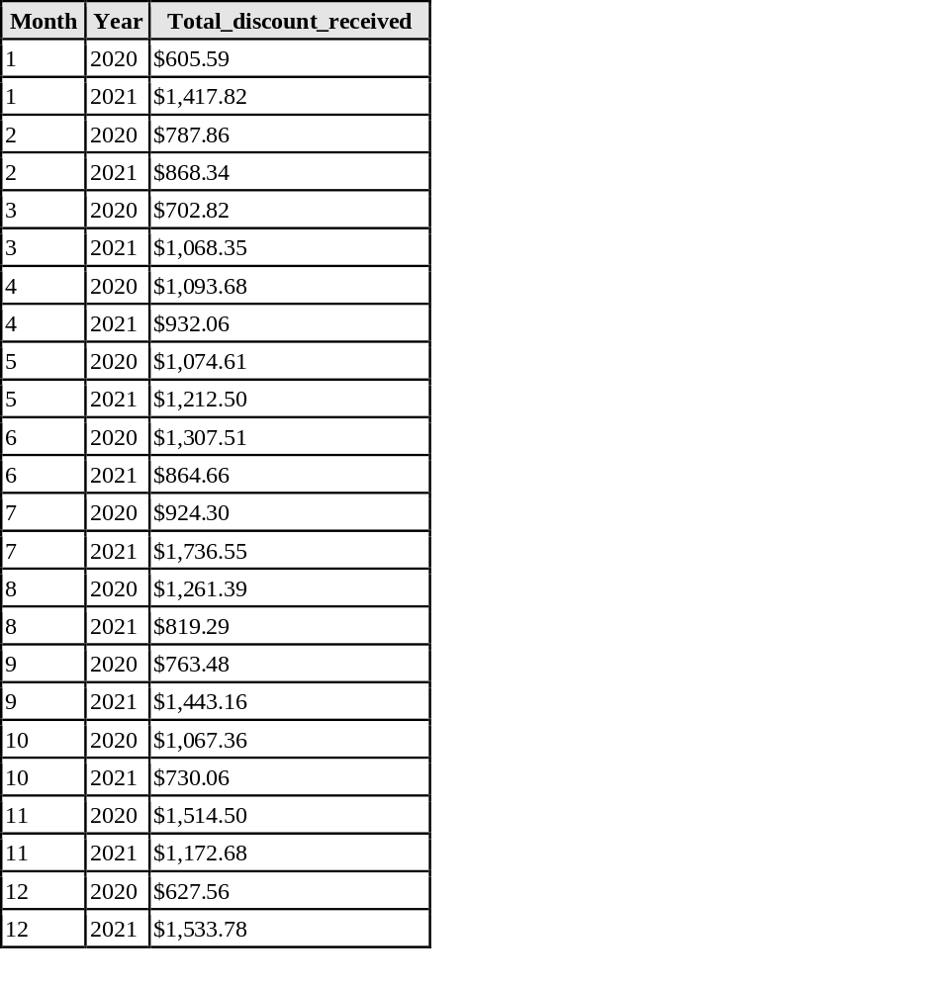
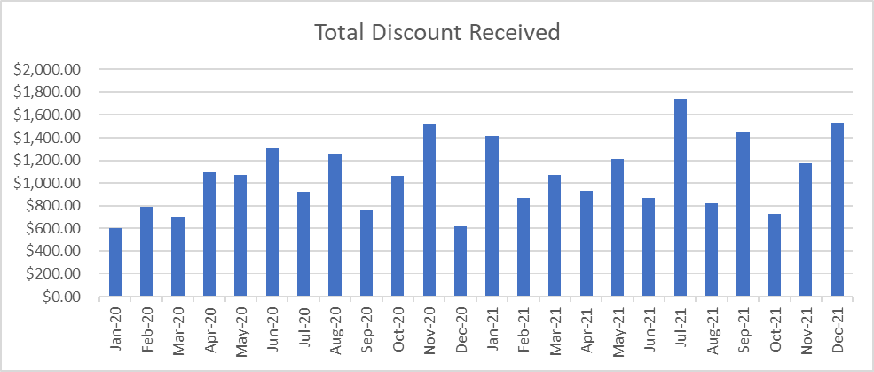
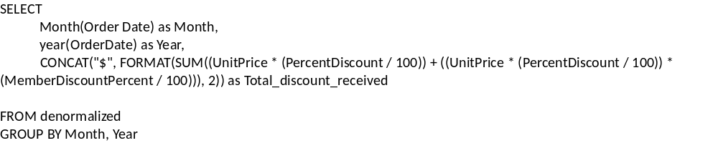
Analytical Question 12
Total discounts received by our customers by month and year - Data Graph and SQL Query
Sample Data
SQL
Graph

Slide 19
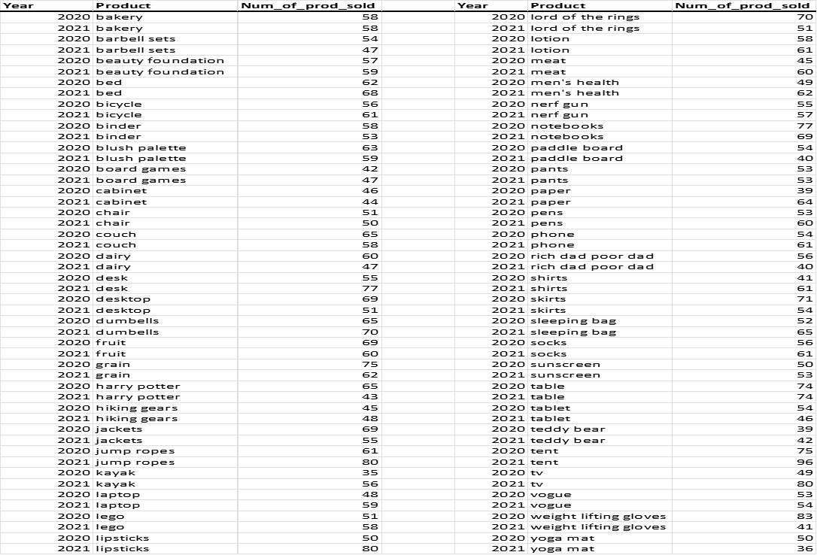
Analytical Question 13
Number of products sold by year
Data Graph and SQL Query (1 of 2)

Slide 20
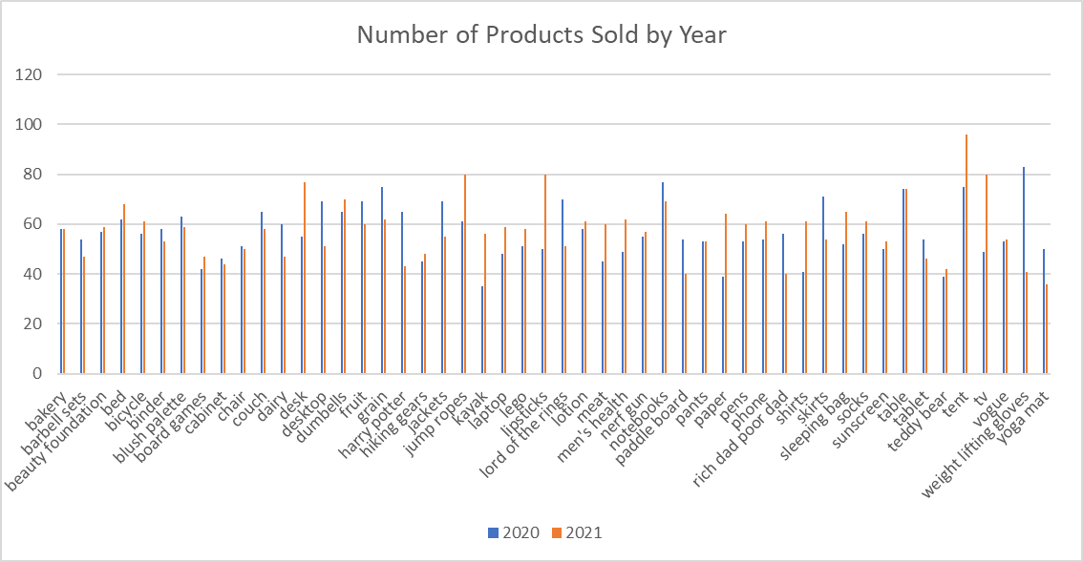
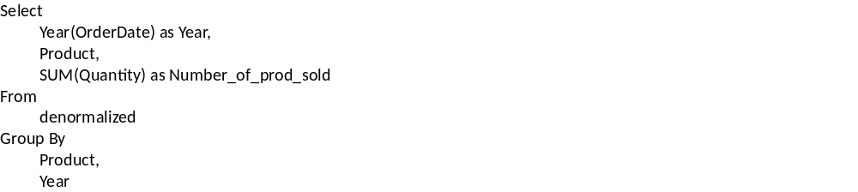
Analytical Question 13
Number of products sold by year
Data Graph and SQL Query (2 of 2)

Slide 21
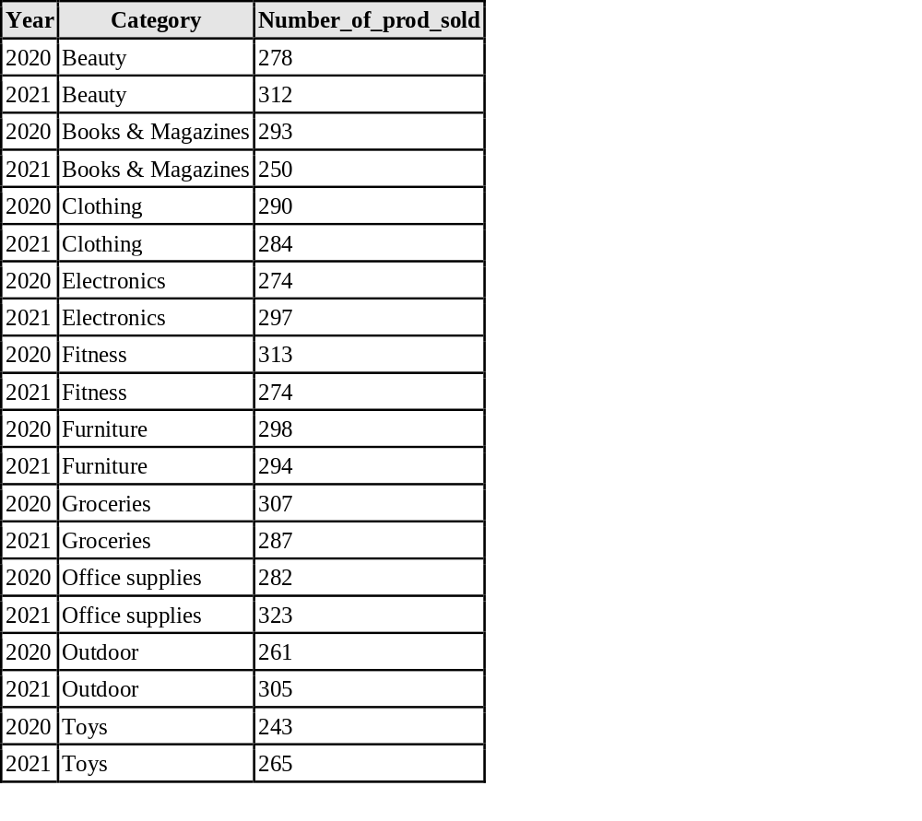
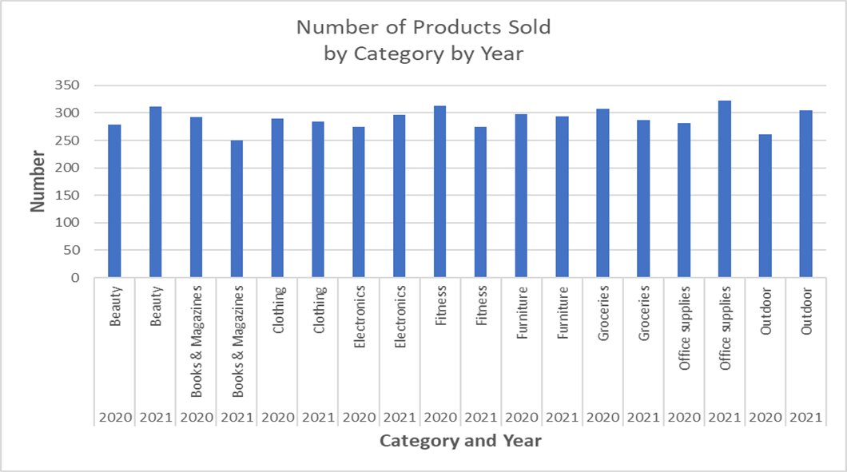
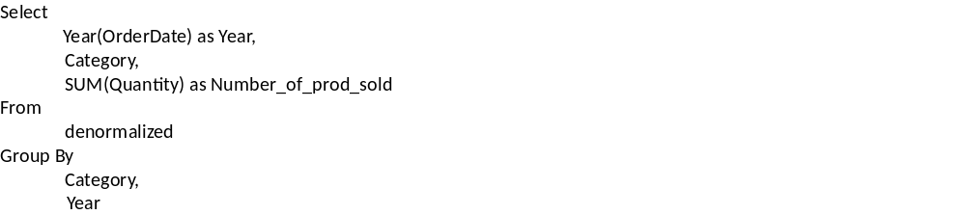
Analytical Question 14
Number of products sold by category by year
Data Graph and SQL Query
Sample Data
SQL
Graph

Slide 22
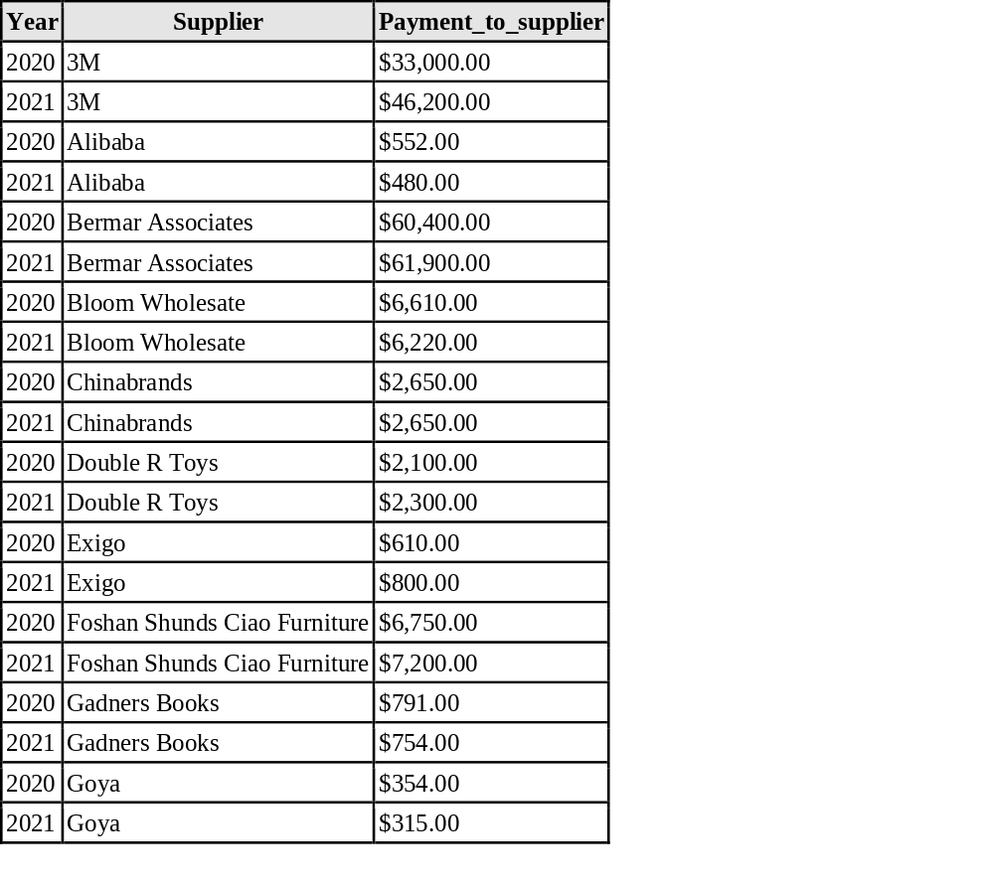
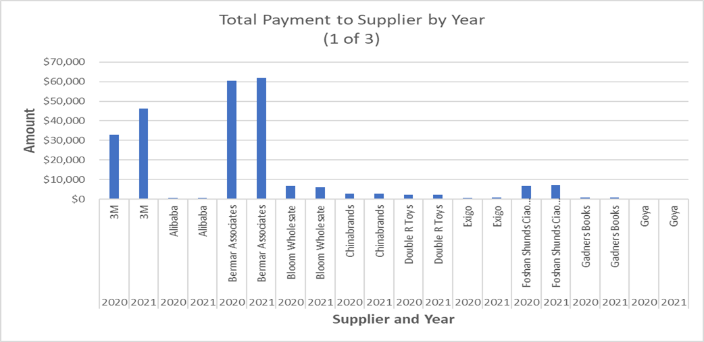
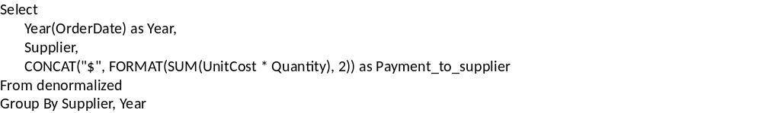
Analytical Question 15
Payment to each supplier by year
Data Graph and SQL Query(1 of 3)
Sample Data
SQL
Graph

Slide 23
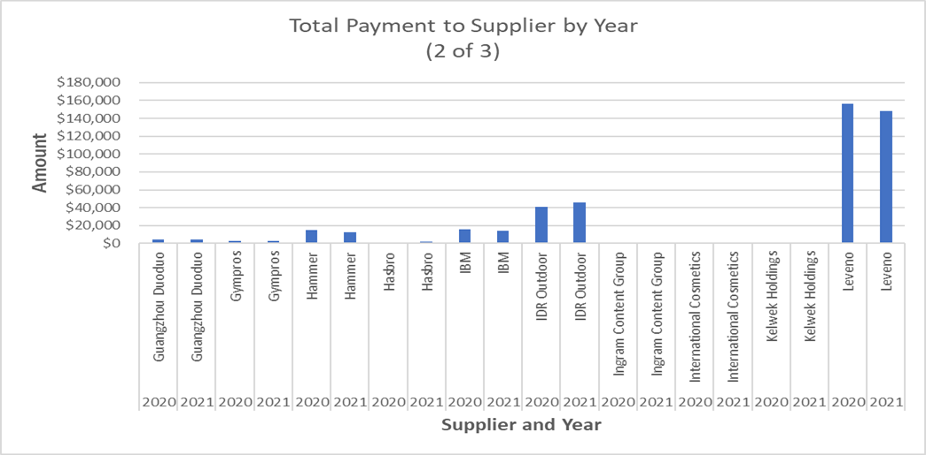

Analytical Question 15
Payment to each supplier by year
Data Graph and SQL Query (2 of 3)
Sample Data
SQL
Graph

Slide 24


Analytical Question 15
Payment to each supplier by year
Data Graph and SQL Query(3 of 3)
Sample Data
SQL
Graph

Slide 25



Analytical Question 16
Total number of products provided by each supplier by year - Data Graph and SQL Query (1 of 3)
Sample Data
SQL
Graph

Slide 26


Analytical Question 16
Total number of products provided by each supplier by year - Data Graph and SQL Query (2 of 3)
Sample Data
SQL
Graph

Slide 27


Analytical Question 16
Total number of products provided by each supplier by year - Data Graph and SQL Query (3 of 3)
Sample Data
SQL
Graph

Slide 28



Analytical Question 17
Total payment to suppliers by country by year Data Graph and SQL Query (1 of 2)
Sample Data
SQL
Graph

Slide 29


Analytical Question 17
Total payment to suppliers by country by year Data Graph and SQL Query (2 of 2)
Sample Data
SQL
Graph

Slide 30



Analytical Question 18
Total discounts received by membership type by year – Data Graph and SQL Query

Slide 31
  Questions?

